Slide 1
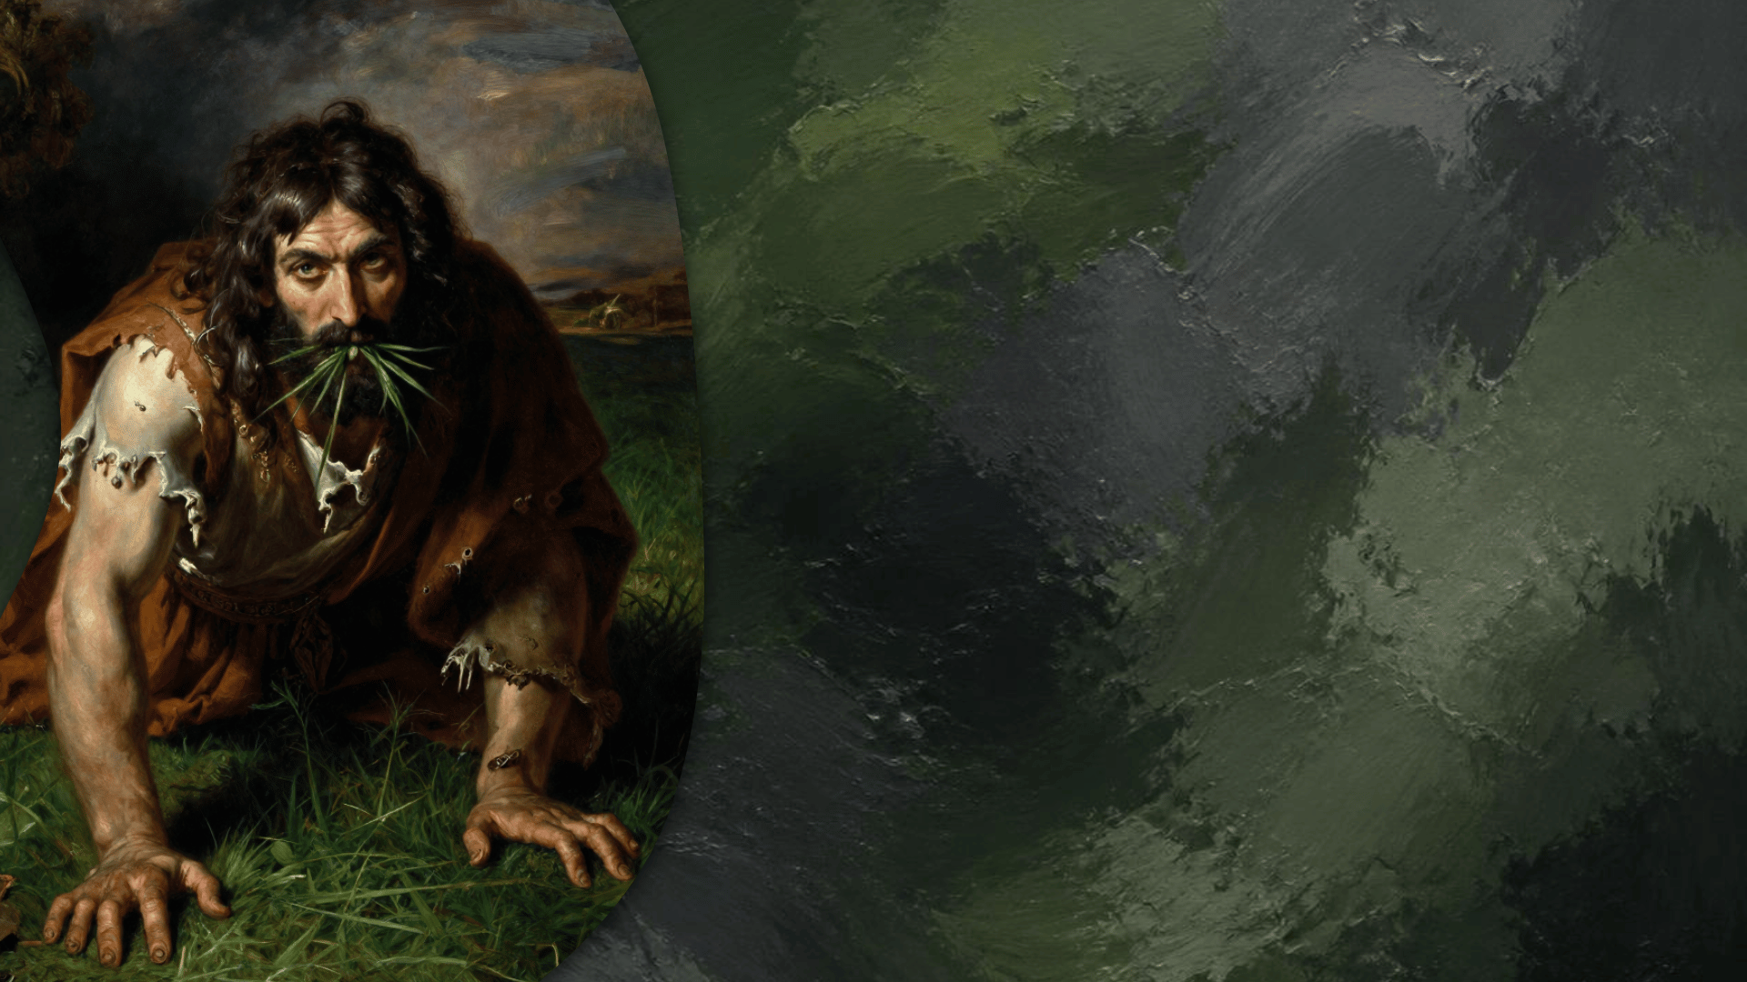
The Pride of
NEBUCHADNEZZAR
Daniel

Slide 2

NEBUCHADNEZZAR’S FAILINGS
An important admission
  (2:47)
Nebuchadnezzar remained an idolater
  (3:4-6); Isaiah 14:13-14; (6:7-9);
  Ezekiel 28:1-2; (11:35-36); Acts 12:21-23; (3:29)
His pride got the best of him
(4:25-26, 36-37)

Slide 3
NEW TESTAMENT TEACHING: PRIDE
Exhortations Against Pride
  Romans 12:3,16; Philippians 2:3; 1 Pe. 5:5-7
The Danger of Pride
  James 4:4-10; Revelation 3:17; 1 Corinthians 10:12
Other Sins that Originate from Pride
Luke 22:24-27; 18:9,14; 1 John 2:16; 1 Timothy 6:3-5
The Fate of the Prideful
Acts 12:23; Luke 1:51-53; Romans 2:8

Slide 4
HOW TO OVERCOME PRIDE
Realistically Examine Yourself
  2 Cor. 10:12; Romans 12:3; 1 Cor. 4:7
Welcome Accountability
  James 5:16; 2 Timothy 3:16-17
Deliberately Choose the Low Place
John 13:13-14; Luke 14:10-11
Endlessly Cultivate Mindful Empathy
Philippians 2:3-4; Romans 12:16

Slide 5
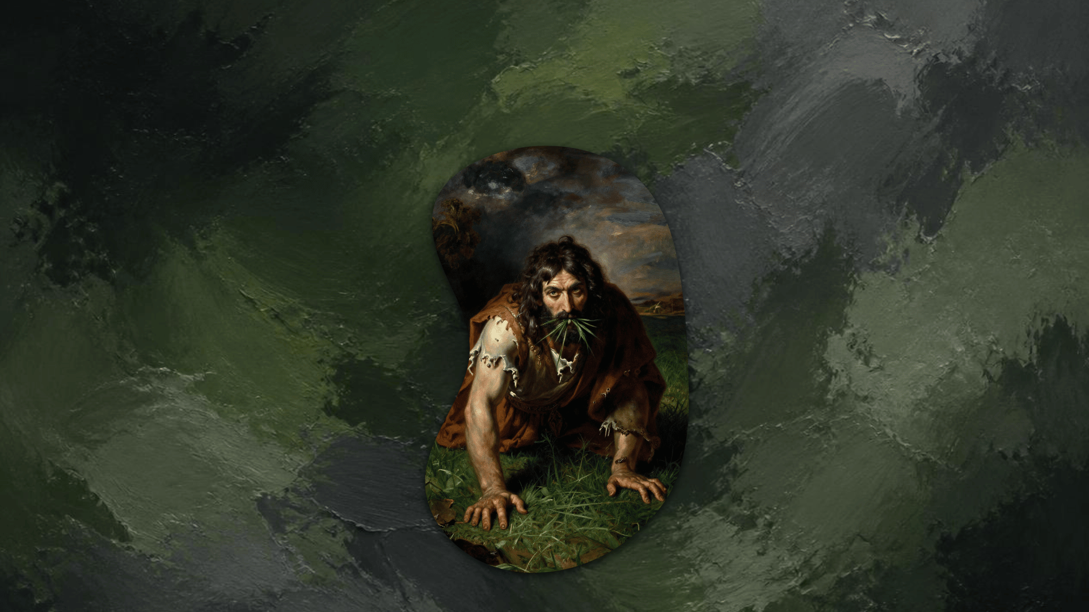
The recipe for success in life, and eternal glory!
CONCLUSION
“Humble yourselves in the sight of the Lord, and He will lift you up.”
James 4:10

